Slide 1
TOPIC
VOLUME OF SOLIDS OF REVOLUTION

Slide 2
OBJECTIVES
At the end of the lesson, the student should be able to:
define what a solid of revolution is.
find the volume of solid of revolution using disk method.
find the volume of solid of revolution using the washer method.
find the volume of solid of revolution using cylindrical shell method.
find the volume of a solid with known cross sections.

Slide 3
DEFINITION
A solid of revolution is the figure formed when a plane region is revolved about a fixed line. The fixed line is called the axis of revolution. For short, we shall refer to the fixed line as axis.
The volume of a solid of revolution may be using the following methods: DISK, RING and SHELL METHOD

Slide 4
A. DISK METHOD: V = πr²h
This method is used when the element (representative strip) is perpendicular to and touching the axis. Meaning, the axis is part of the boundary of the plane area. When the strip is revolved about the axis of rotation a DISK is generated.

Slide 5
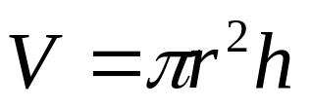
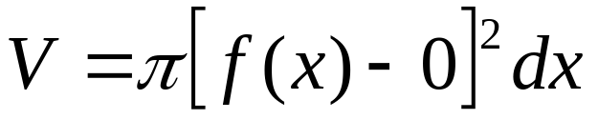
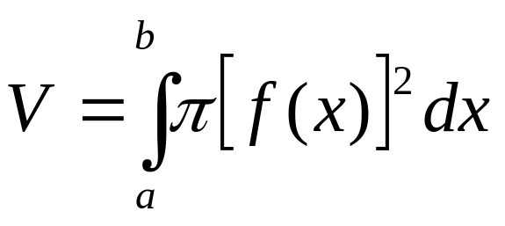
y
y = f(x)
h = dx
f(x) - 0
= r
x
dx
x = a
x = b
The solid formed by revolving the strip
is a cylinder whose volume is
To find the volume of the entire solid

Slide 6
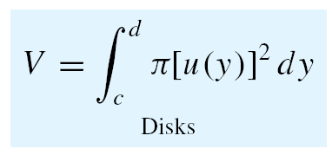
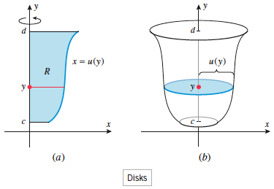

Slide 7
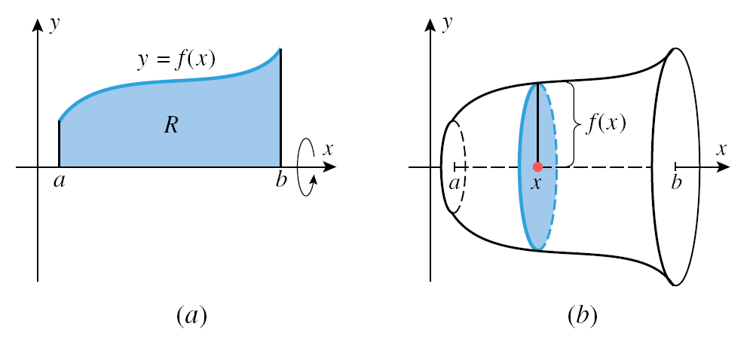
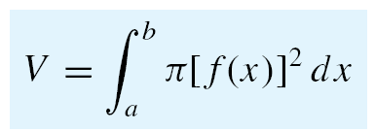
Equation
Volume by disks

Slide 8
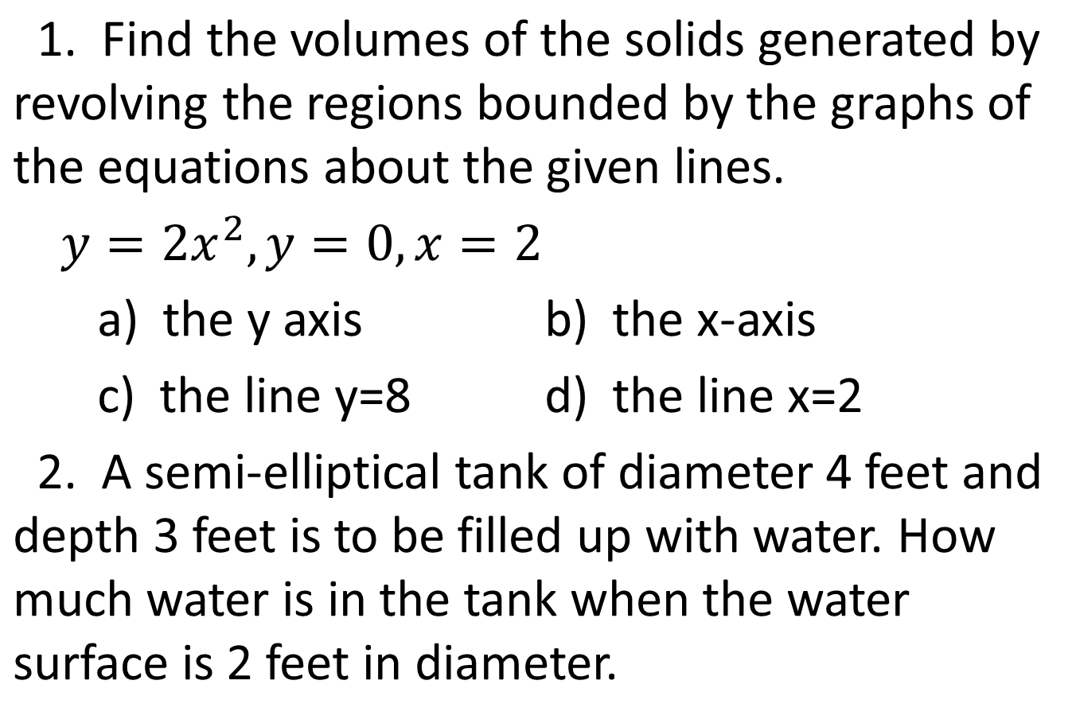
EXAMPLE

Slide 9
B. RING OR WASHER METHOD: V = π(R² – r²)h
Ring or Washer method is used when the element (or representative strip) is perpendicular to but not touching the axis. Since the axis is not a part of the boundary of the plane area, the strip when revolved about the axis generates a ring or washer.

Slide 10


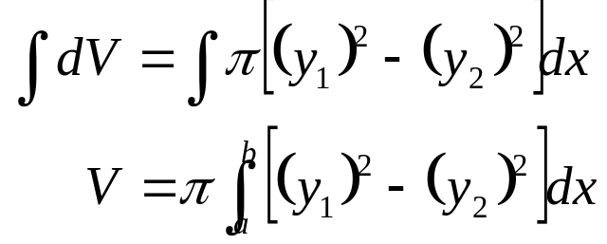


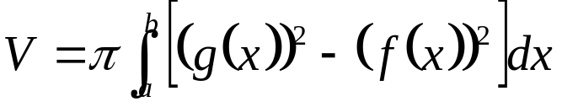
y₁ = g(x)
y₂ = f(x)
h = dx
(x₁ , y₁)
(x₂ , y₂)
dx
x = a
x = b
Since
and

Slide 11
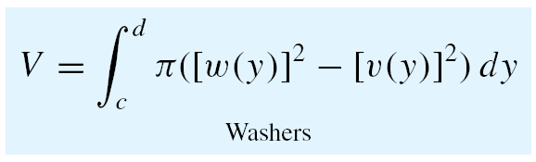
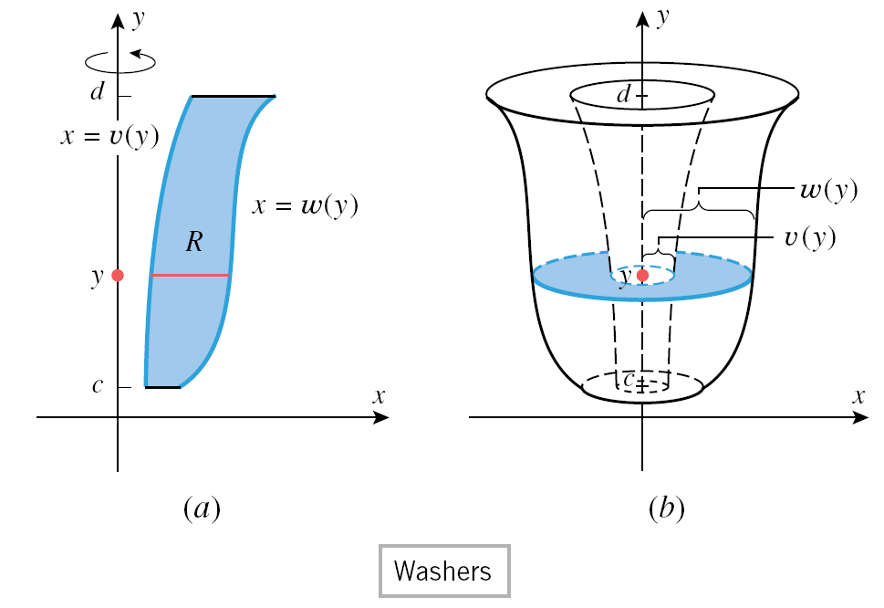

Slide 12
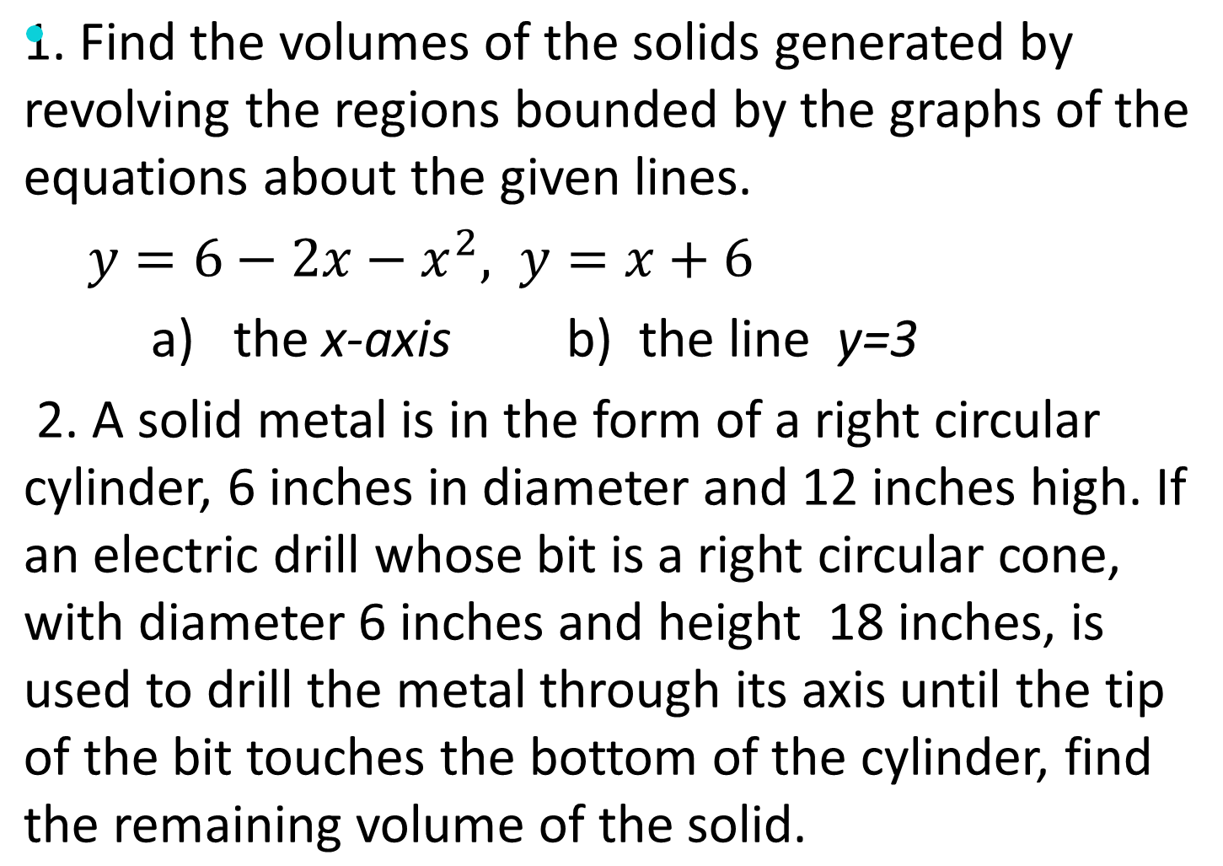
EXAMPLE

Slide 13
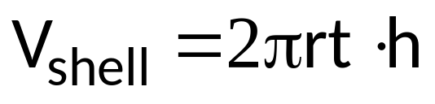
C. SHELL METHOD
The method is used when the element (or representative strip) is parallel to the axis of revolution. When this strip is revolved about the axis, the solid formed is of cylindrical form.

Slide 14
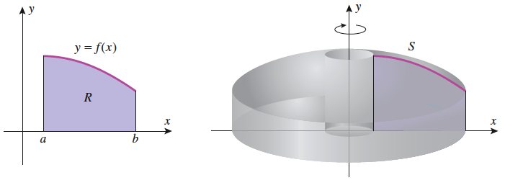

Slide 15
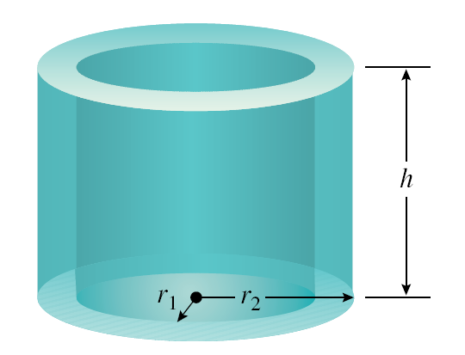

Slide 16
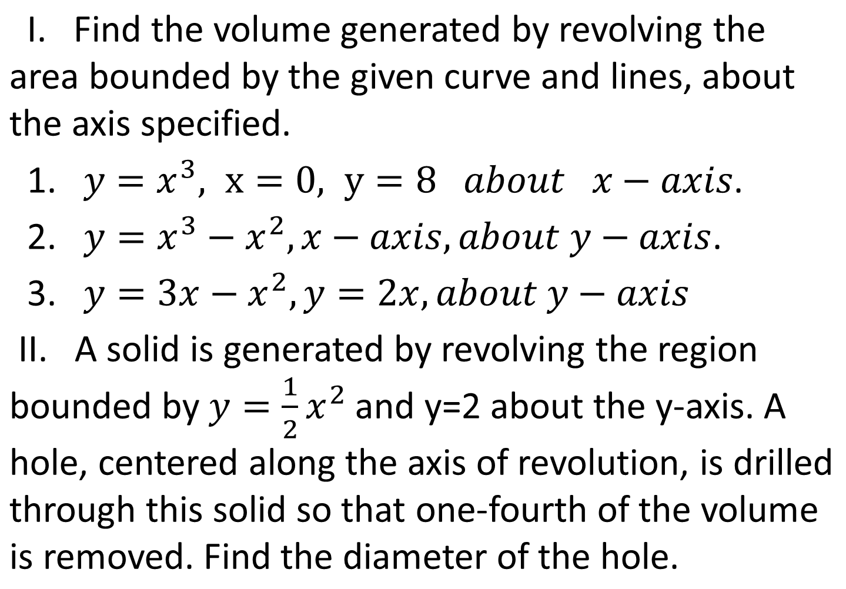
EXAMPLE

Slide 17
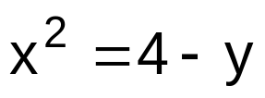


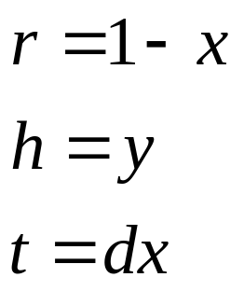
EXAMPLE
Find the volume of the solid generated by revolving the second quadrant region bounded by the curve about
Using vertical stripping, the elements parallel to the axis of revolution, thus we use the shell method.
Shell Method:

Slide 18
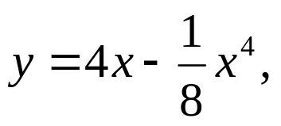
HOMEWORK
Using disk or ring method, find the volume generated by revolving
about the indicated axis the areas bounded by the following curves:
  y = x³, y = 0, x = 2; about x-axis
  y = 6x – x², y = 0; about x-axis
  y² = 4x, x = 4; about x = 4
  y = x², y² = x; about x = -1
  y = x² – x, y = 3 – x²; about y = 4
B. Using cylindrical shell method, find the volume generated by revolving
about the indicated axis the areas bounded by the following curves:
1. y = 3x – x², the y-axis, y = 2; about y-axis
2.
y-axis, about x=2
  3. y = x³, x = y³; about x-axis

Slide 19
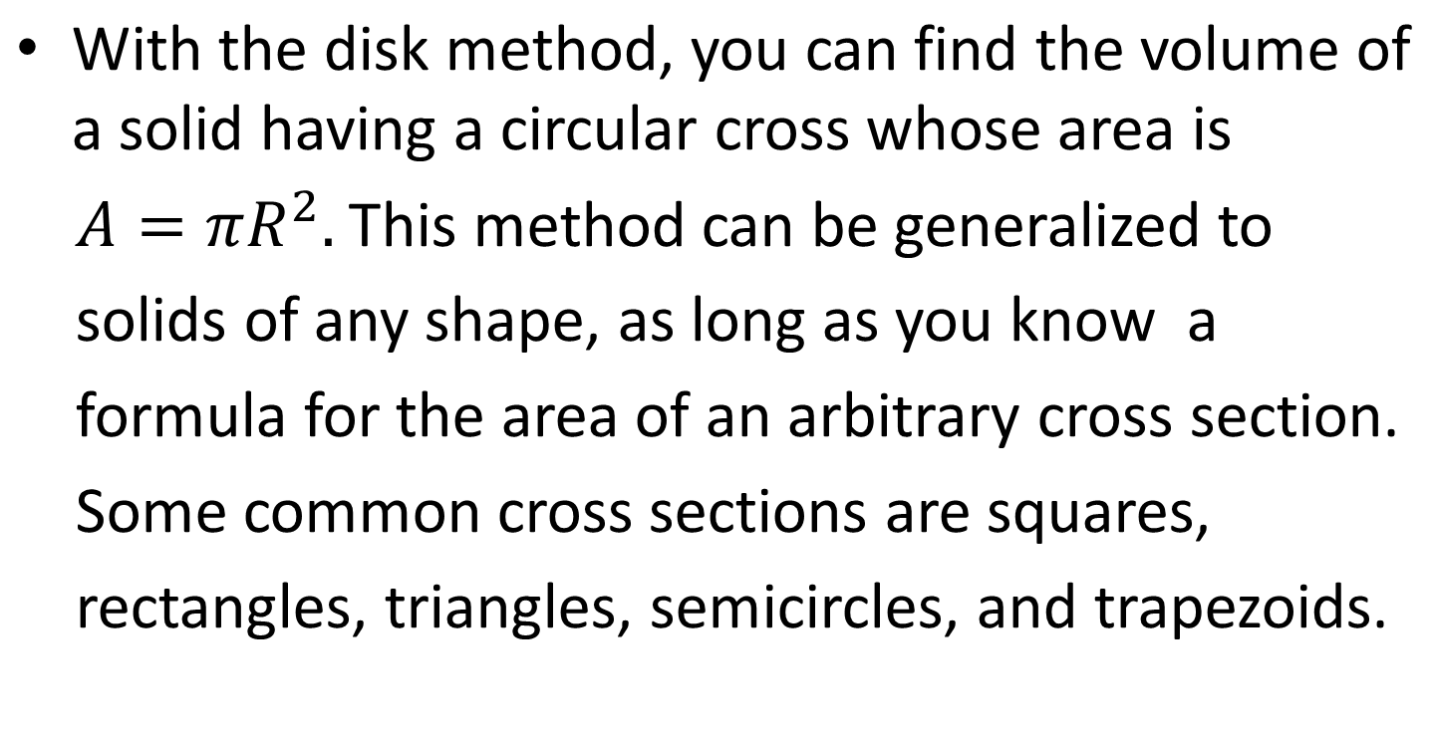
SOLIDS WITH KNOWN CROSS SECTIONS

Slide 20
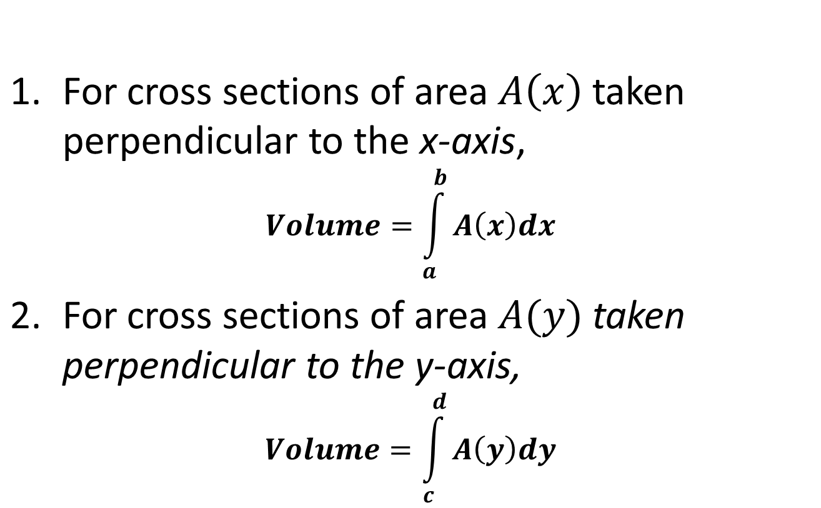
VOLUMES OF SOLID WITH KNOWN CROSS SECTIONS

Slide 21
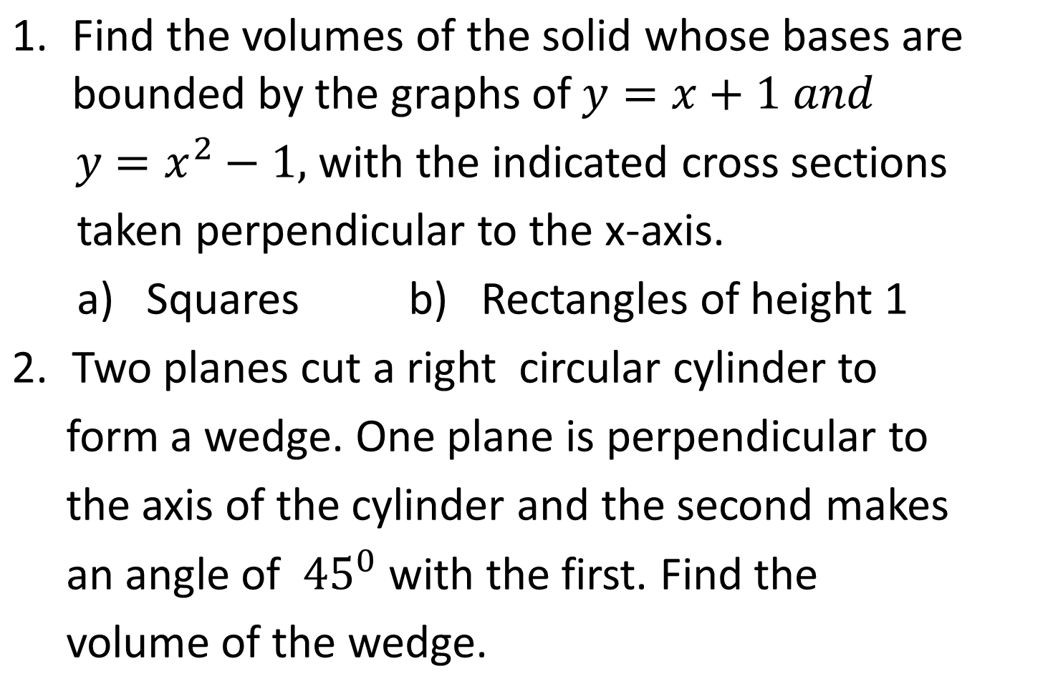
EXAMPLE

